Slide 1
Scheme Consultations

Slide 2
Purpose
Provide update on HMRC calculator
Demonstrate the data sharing solution
Gain schemes input on data shared
Provide a guidance and comms update

Slide 3
Delivery overview
HMRC will be delivering:
  A calculator for customers to use in order to calculate their tax adjustments
  An application route for customers to provide us with their tax adjustments
  A compliance process for claims
  A secure way of sending schemes the data necessary so they can process customers compensation claims

Slide 4
Delivery overview - timeline
Alpha Began
Prototype Development
User Research
Consultation with schemes- second round
Back end development starts
Beta begins
Private Beta – open service to a small number of users for testing
Go Live
Oct 2023
Nov 2022
Nov 2022- February 23
November 22-onwards
January- Feb 23
February 2023
April 2023
September 2023

Slide 5
Calculator Process

Slide 6
Using SDES
Secure Data Exchange Service

Slide 7
Registration
You will be invited to register for SDES with an email from HMRC
This will contain instructions for registering and a registration code
You will need to enter the code to register and you will be asked for some details
Once your email has been verified, you will receive a SDES Registration Number (SRN). This is an unique number used to identify your organisation if you need assistance with SDES. We will email this to you. Please keep it safe.
You will then need to sign in with a Government Gateway (Business Tax Account) login or sign up for a new account.

Slide 8
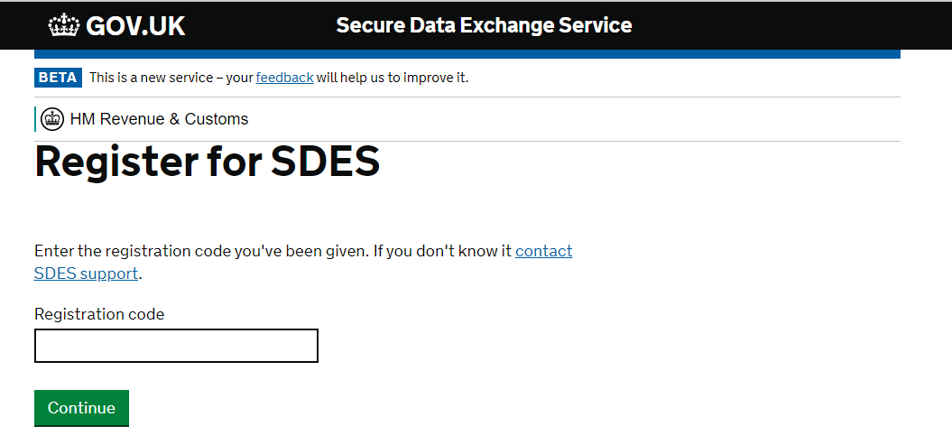

Slide 9
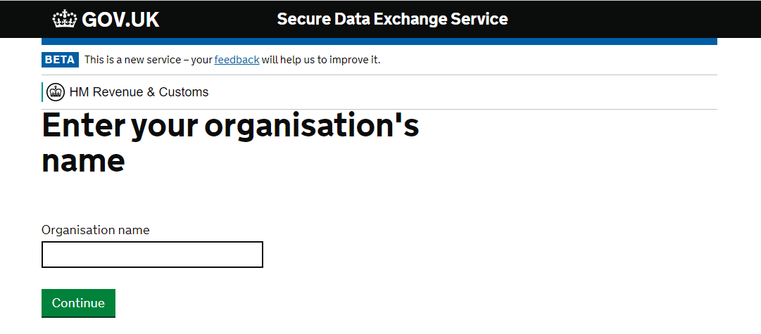

Slide 10
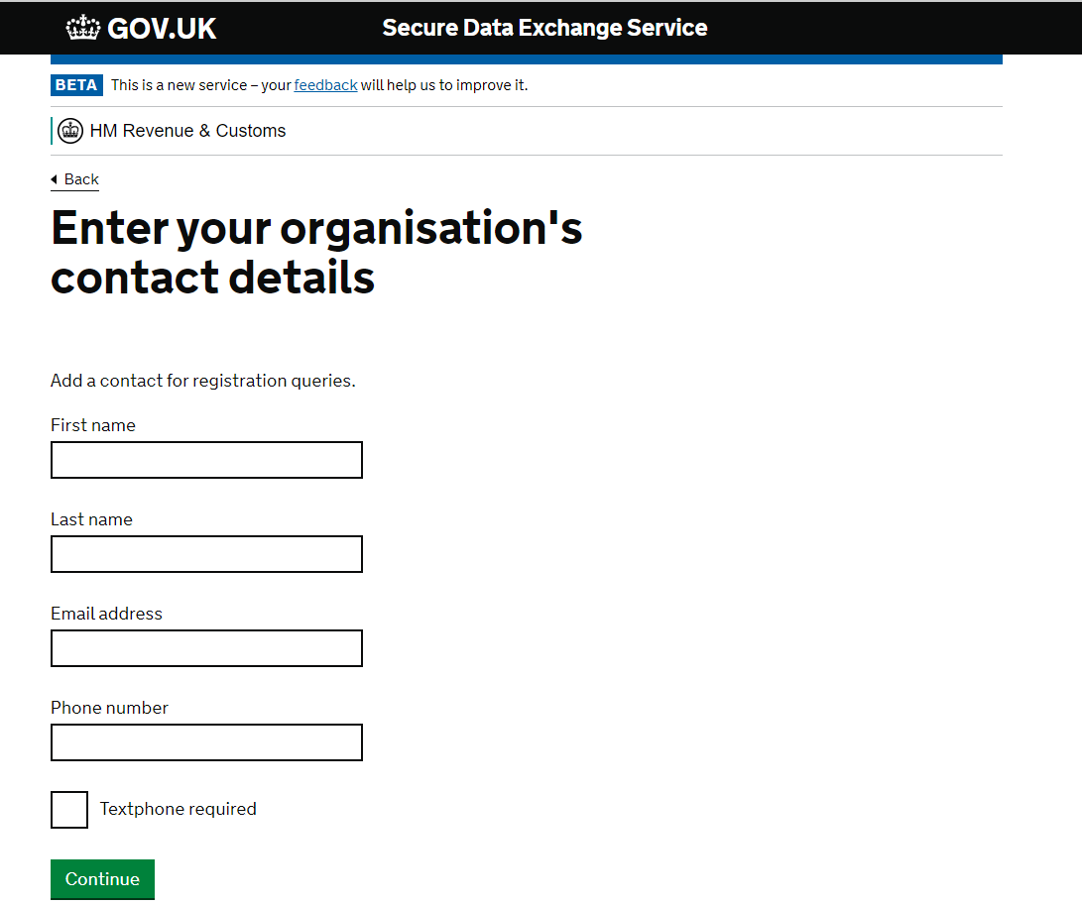

Slide 11
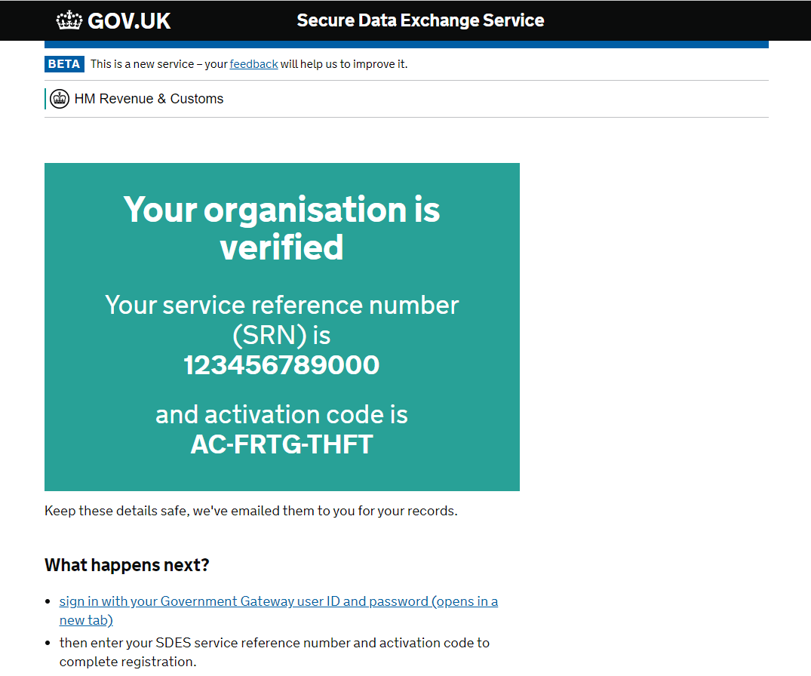

Slide 12
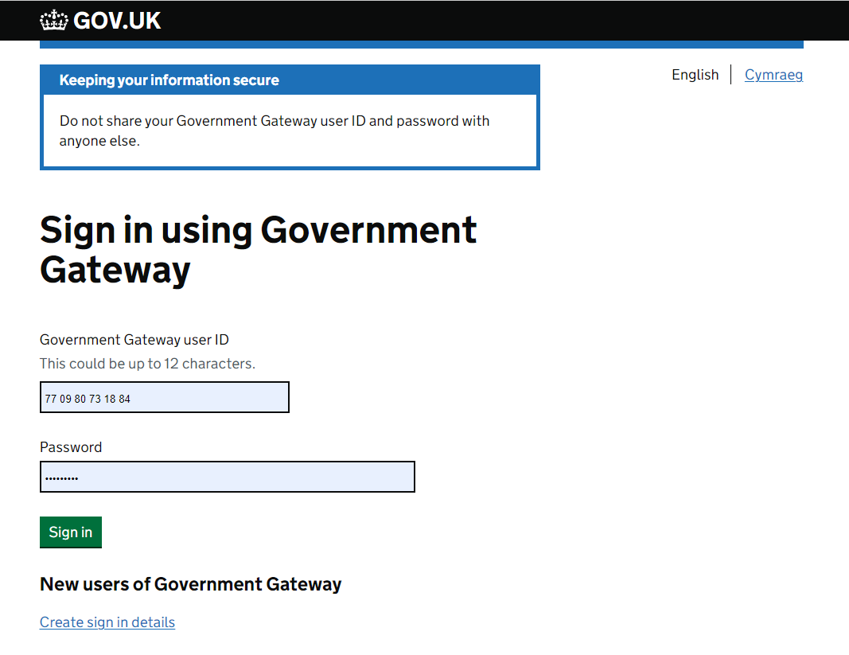

Slide 13
Uploading Files
SDES can be used for files up to 4GB in size
All filetypes can uploaded apart from executable files (e.g. .exe, .app)
SDES virus scans and encrypts all files, so files do not need to be protected or encrypted before upload
File uploads can be tracked to ensure they are successful
Email notifications are sent for confirmation and if there are any issues

Slide 14
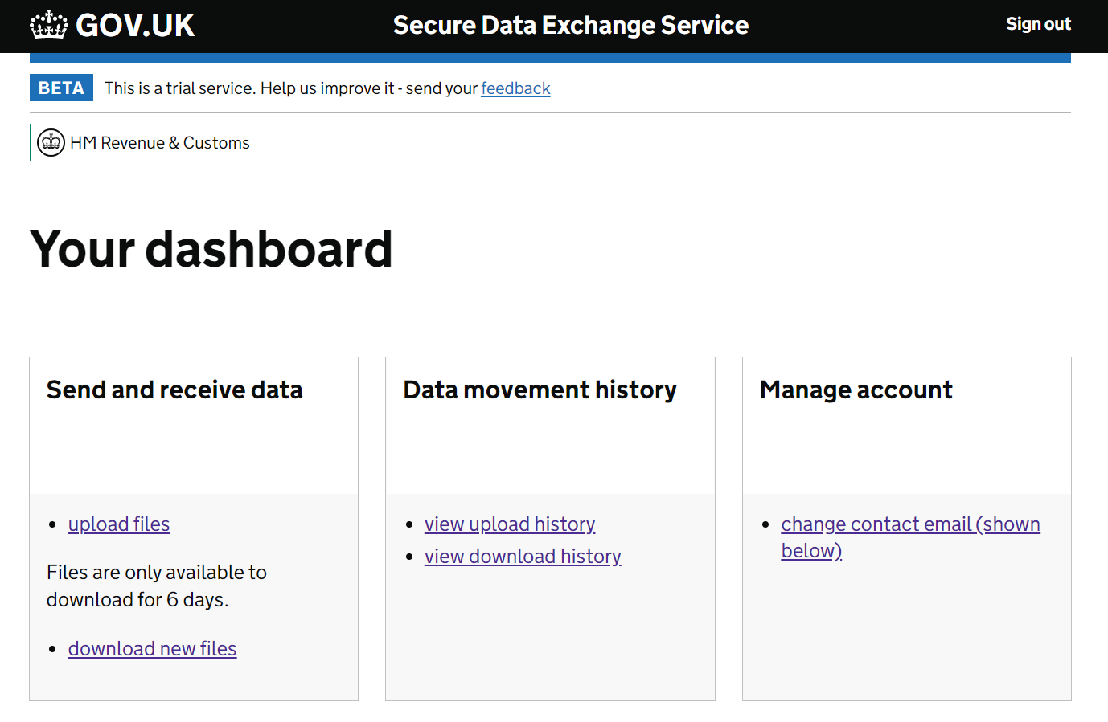

Slide 15
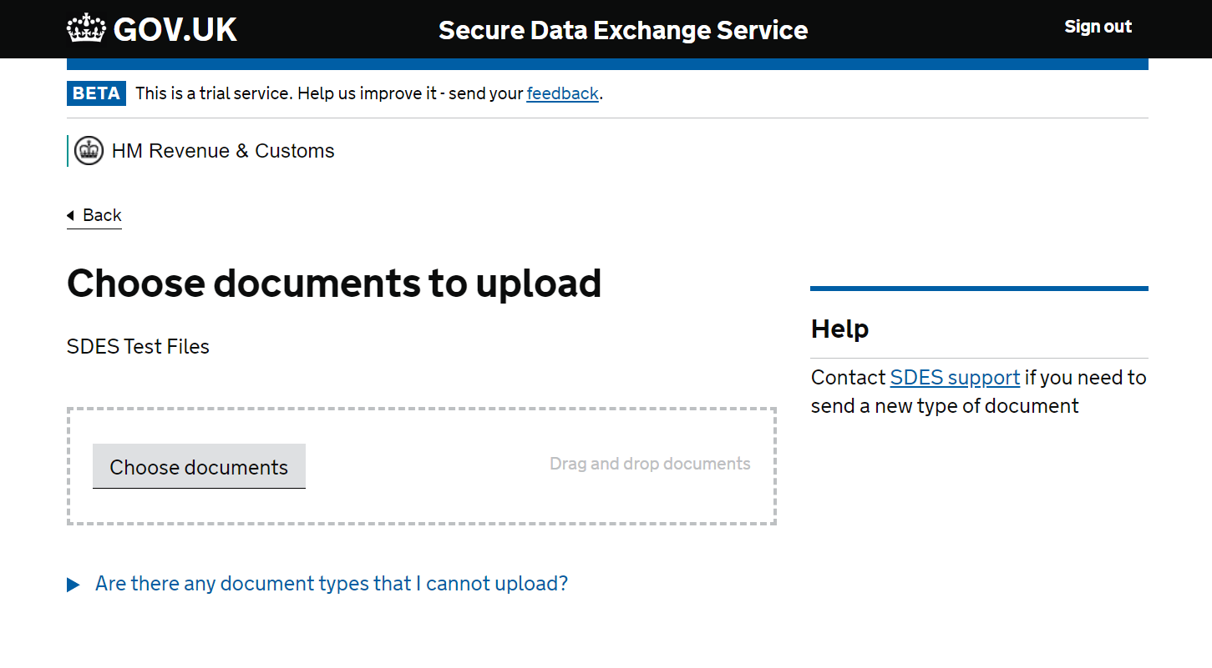

Slide 16
Downloading Files
When you are sent a file from HMRC, you will receive an email notification
Files are available to download for six days before they are securely deleted
Files can be downloaded multiple times within those six days

Slide 18
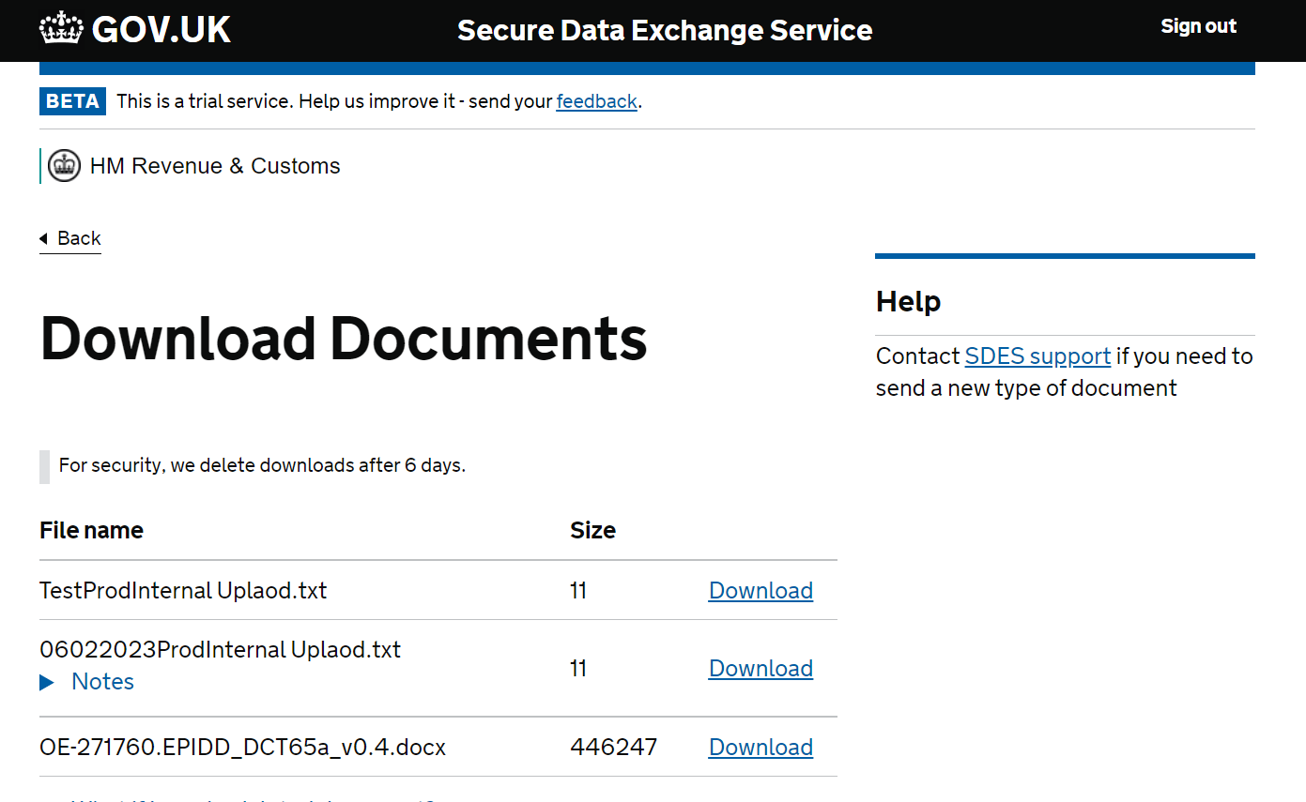

Slide 19
Other Features
A group mailbox can be used for notification emails about uploads and downloads
Users can be added/removed from the SDES account via the business tax account. This gives users their own login details but shared access to the same SDES account
Full audit history of files uploaded and downloaded

Slide 20
Compensation Response – Reason Codes
Description | Direct/Indirect | Error Code
Reported and fully paid on Accounting for Tax, not reported on Self Assessment | Indirect | A
Reported on Accounting for Tax and Self Assessment, payments outstanding | Indirect | B
Reported on Self Assessment but not on Accounting for Tax and payment outstanding | Indirect | C
Discrepancy between claim and reported amounts on Accounting for Tax and Self Assessment | Indirect | D
Discrepancy between claim and reported amounts on Accounting for Tax | Indirect | E
Charge reported and paid by another scheme | Indirect | F
Not reported or paid on Self Assessment | Direct | G
Reported on Self Assessment, payments outstanding | Direct | H
Discrepancy between claim and reported amounts on Self Assessment | Direct | I
Amendment | Both | J

Slide 21
Compensation Response
Do you want to receive separate CSV files for Annual Allowance and Lifetime Allowance?
Do you want to receive separate CSV files for members applying for compensation and third parties applying on behalf of a member?

Slide 22
Compensation – Member Declaration
As part of the compensation claim process, we will be asking the member to complete a declaration
As it is schemes who will be making the compensation payments, we would like your views on what you would like the declaration/s to contain
Happy to take views now, or receive them by email once you’ve had a chance to consider in more detail

Slide 23
Memorandum of Understanding (MoU)
Signed by HMRC and other government departments
Sets out what information is being shared, how and how it will be used
Confirms retention periods

Slide 24

Guidance and Comms

Slide 25
Next Steps
Contact details:
Luke Friis
luke.friis@hmrc.gov.uk

